Slide 1
Artificial Intelligence
CS-451
Instructor : Syed Musharaf Ali
ROOM G-104-DSE IIUI
Ph# 051-9019724 Ext-2724

Slide 2
Artificial Neural Networks (ANNs)
Neural networks are parallel computing devices, which is basically an attempt to make a computer model of the brain.
The main objective is to develop a system to perform various computational tasks faster than the traditional systems.
Notes:
Cognitve : process of knowing, learning

Slide 3
Artificial Neural Networks (ANNs)
Artificial Neural Network (ANN) is an efficient computing system whose central theme is borrowed from the analogy of biological neural networks.
ANN acquires a large collection of units that are interconnected in some pattern to allow communication between the units. These units, also referred to as nodes or neurons, are simple processors which operate in parallel.
Notes:
Cognitve : process of knowing, learning

Slide 4
Artificial Neural Networks (ANNs)
Every neuron is connected with other neuron through a connection link.
Each connection link is associated with a weight that has information about the input signal. This is the most useful information for neurons to solve a particular problem because the weight usually excites or inhibits the signal that is being communicated.
Each neuron has an internal state, which is called an activation signal. Output signals, which are produced after combining the input signals and activation rule, may be sent to other units.
Notes:
Cognitve : process of knowing, learning

Slide 5
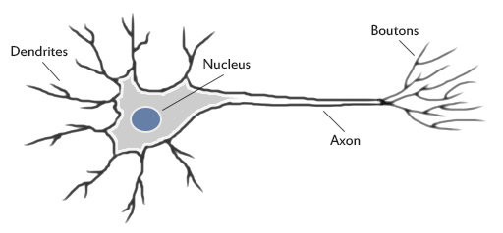
Artificial Neural Networks (ANNs)
A nerve cell (neuron) is a special biological cell that processes information.
According to an estimation, there are huge number of neurons, approximately 10¹¹ with numerous interconnections, approximately 10¹⁵
Notes:
Cognitve : process of knowing, learning

Slide 6
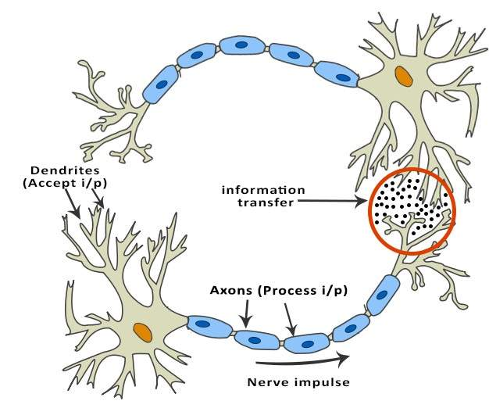
Artificial Neural Networks (ANNs)
First lets take a look at what a biological neuron looks like.
A neuron collects inputs using a structure called dendrites, the neuron effectively sums all of these inputs from the dendrites and if the resulting value is greater than it's firing threshold, the neuron fires. When the neuron fires it sends an electrical impulse through the neuron's axon to it's boutons. These boutons can then be networked to thousands of other neurons via connections called synapses. There are about one hundred billion (100,000,000,000) neurons inside the human brain each with about one thousand synaptic connections. It's effectively the way in which these synapses are wired that give our brains the ability to process information the way they do.
Notes:
Cognitve : process of knowing, learning

Slide 7
Artificial Neural Networks (ANNs)
Working of a Biological Neuron
A typical neuron consists of the following four parts
Dendrites − They are tree-like branches, responsible for receiving the information from other neurons it is connected to.
Soma/Nucleus − It is the cell body of the neuron and is responsible for processing of information, they have received from dendrites.
Axon − It is just like a cable through which neurons send the information.
Synapses − It is the connection between the axon and other neuron dendrites.
Notes:
Cognitve : process of knowing, learning

Slide 8
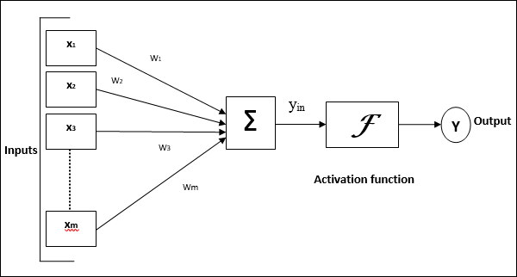
Modeling Artificial Neurons
Artificial neuron models are at their core simplified models based on biological neurons.
We usually refer to these artificial neurons as 'perceptrons'.
Notes:
Cognitve : process of knowing, learning

Slide 9
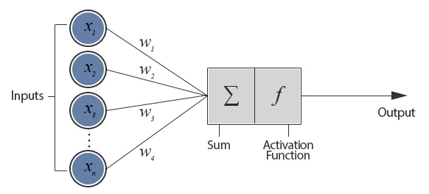
Modeling Artificial Neurons
The perceptron weights can either amplify or de-amplify the original input signal.
For example, if the input is 1 and the input's weight is 0.2 the input will be decreased to 0.2.
Notes:
Cognitve : process of knowing, learning

Slide 10
Modeling Artificial Neurons
Weighted signals are then added together and passed into the activation function.
The activation function is used to convert the input into a more useful output.
There are many different types of activation function but one of the simplest would be step function.
A step function will typically output a 1 if the input is higher than a certain threshold, otherwise it's output will be 0.
Notes:
Cognitve : process of knowing, learning

Slide 11


Modeling Artificial Neurons
For the above general model of artificial neural network, the net input can be calculated as follows
The output can be calculated by applying the activation function over the net input.
Notes:
Cognitve : process of knowing, learning

Slide 12
Modeling Artificial Neurons
Here's an example of how this might work:
Input 1 (x₁) = 0.6 Input 2 (x₂) = 1.0 Weight 1 (w₁) = 0.5 Weight 2 (w₂) = 0.8 Threshold = 1.0 First we multiply the inputs by their weights and sum them:
x₁w₁ + x₂w₂ = (0.6 x 0.5) + (1 x 0.8) = 1.1 Now we compare our input total to the perceptron's activation threshold.
In this example the total input (1.1) is higher than the activation threshold (1.0) so the neuron would fire.
Notes:
Cognitve : process of knowing, learning

Slide 13
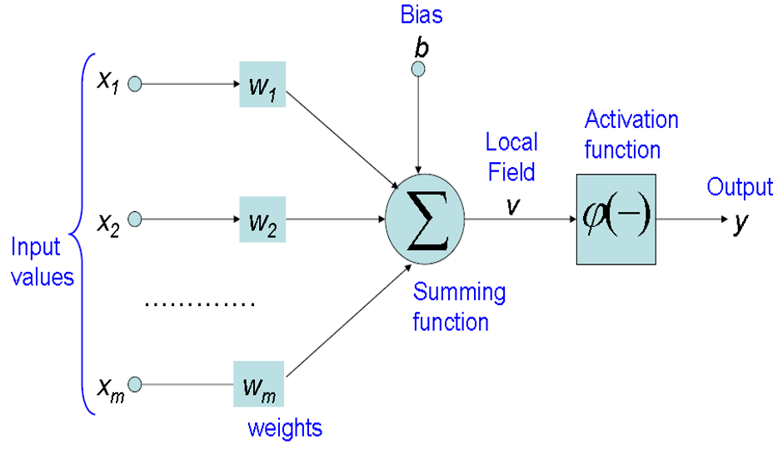
Artificial Neural Networks
A Single Neuron

Slide 14
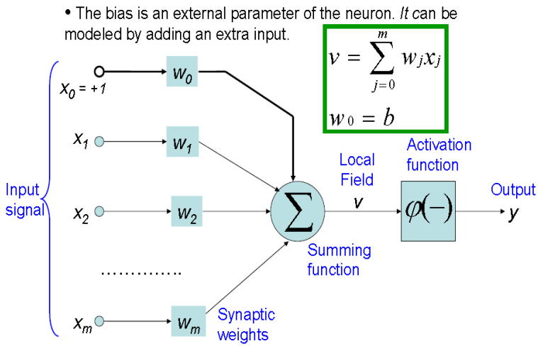
Artificial Neural Networks

Slide 15
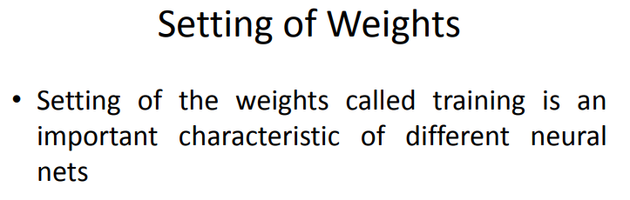
Artificial Neural Networks

Slide 16
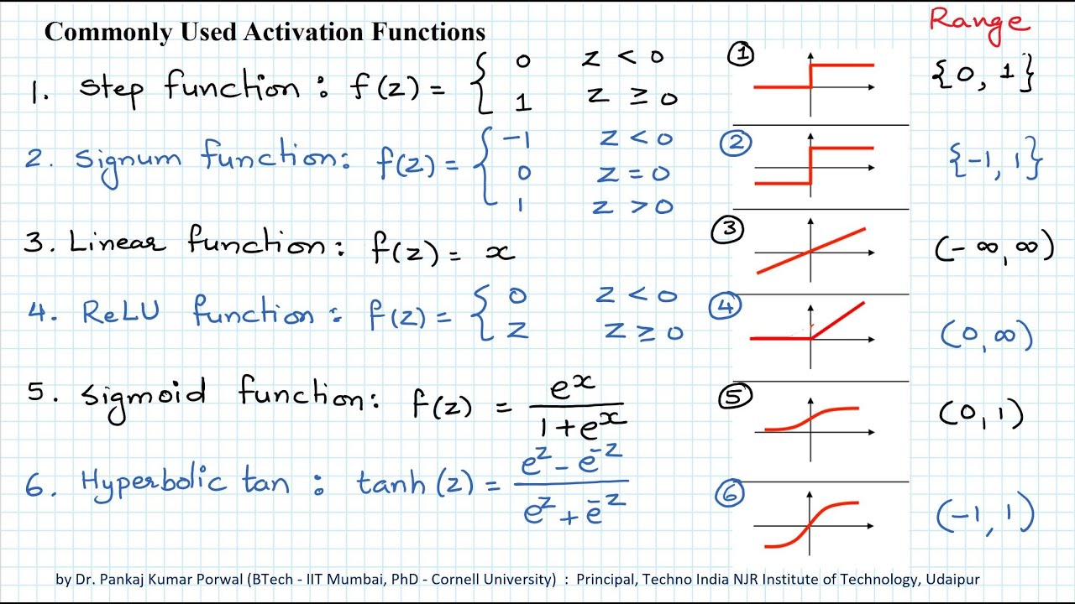
Artificial Neural Networks

Slide 17
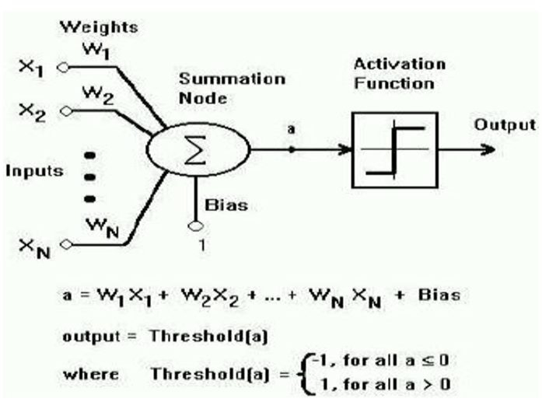
Artificial Neural Networks
2 class classification problem

Slide 18
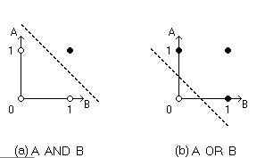
Artificial Neural Networks
2 class classification problem

Slide 19
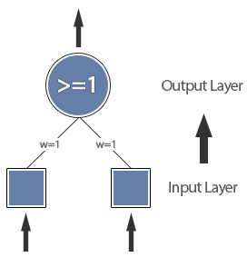
Example: OR function
OR function can be modelled with a single perceptron
Notes:
Cognitve : process of knowing, learning

Slide 20
Learning in Artificial Neural Networks
Artificial neural networks can model learning process by adjusting the weighted connections found between neurons in the network.
The learning process within artificial neural networks is a result of altering the network's weights.
The objective is to find a set of weight matrices which when applied to the network should - map any input to a correct output.
Notes:
Cognitve : process of knowing, learning

Slide 21
Implementing Supervised Learning
output = f( input1 × weight1 + input2 × weight2 + ... )
error = target output - output
New weight = learning rate × error × input + old weight
If the learning rate (r) is too high the perceptron can jump too far and miss the solution, if it's too low, it can take an unreasonably long time to train.
Range of learning rate (r) is between 0 to 1
Notes:
Cognitve : process of knowing, learning

Slide 22
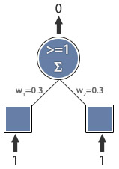
Implementing Supervised Learning
Example: AND function
Learning rate = 0.1
Expected output = 1
Actual output = 0
Error = 1
Weight Update:
wi = r E x + wi
w1 = 0.1 x 1 x 1 + w1
w2 = 0.1 x 1 x 1 + w2
New Weights:
w1 = 0.4
w2 = 0.4
Notes:
Cognitve : process of knowing, learning

Slide 23

Implementing Supervised Learning
Example: AND function
Learning rate = 0.1
Expected output = 1
Actual output = 0
Error = 1
Weight Update:
wi = r E x + wi
w1 = 0.1 x 1 x 1 + w1
w2 = 0.1 x 1 x 1 + w2
New Weights:
w1 = 0.5
w2 = 0.5
Notes:
Cognitve : process of knowing, learning

Slide 24

Implementing Supervised Learning
Example: AND function
Learning rate = 0.1
Expected output = 1
Actual output = 1
Error = 0
No error,
training complete.
Notes:
Cognitve : process of knowing, learning

Slide 25
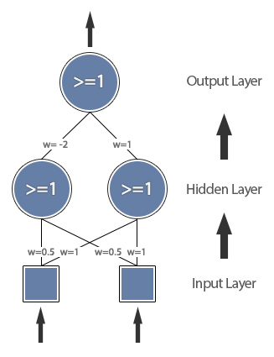
Example: XOR function
XOR function can be modelled with a multi layer perceptron
Notes:
Cognitve : process of knowing, learning

Slide 26
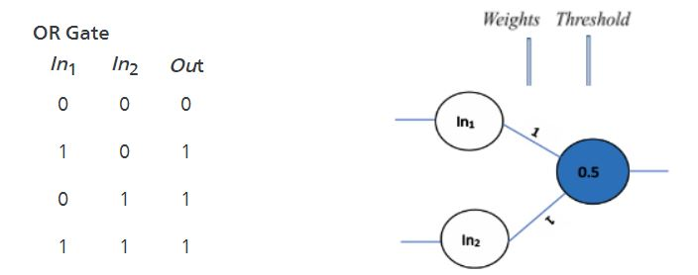
If you give the first set of inputs to the network i.e. (0, 0) it gets multiplied by the weights of the network to get the sum as follows: (0*1) + (0*1) = 0. Here, the sum, 0, is less than the threshold, 0.5, hence the output will be 0
Whereas, for the second set of inputs (1,0), the sum (1*1) + (0*1) = 1 is greater than the threshold, 0.5, hence the output will be 1.
Notes:
Cognitve : process of knowing, learning

Slide 27
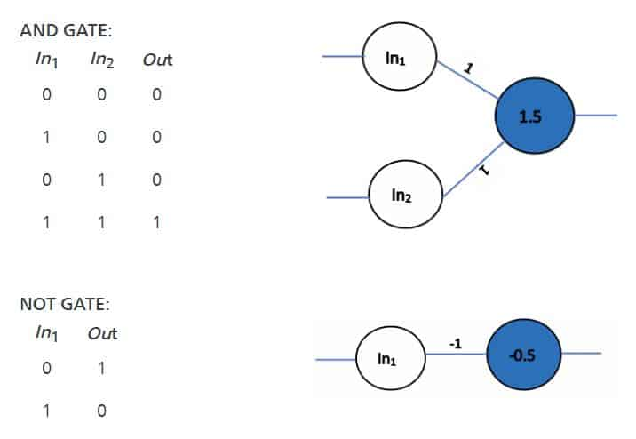
Notes:
Cognitve : process of knowing, learning

